Slide 1
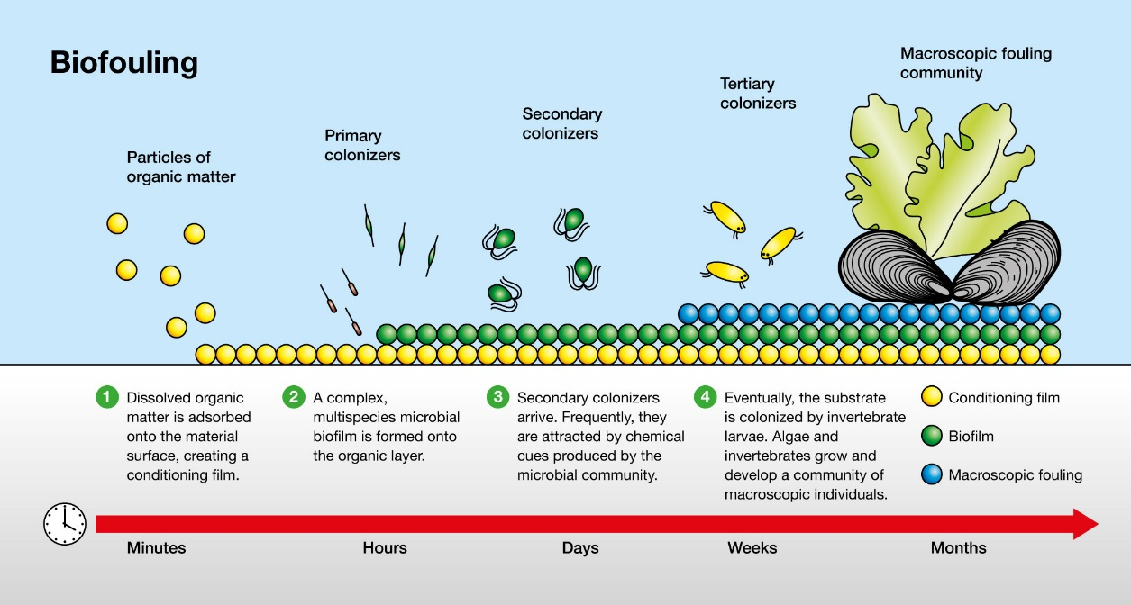
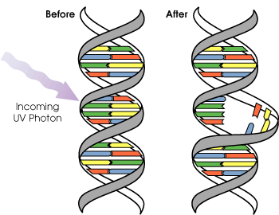
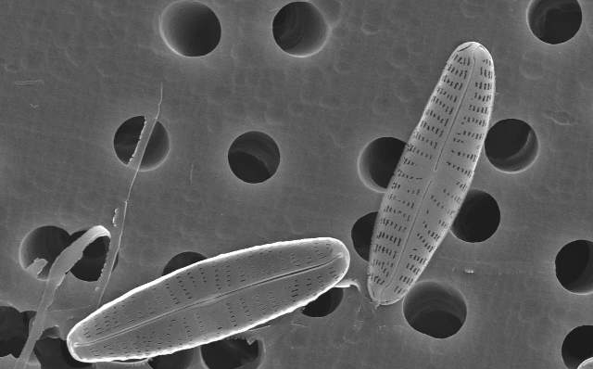
UV-C LIGHT EMITTING DIODES (LEDs) FOR MARINE BIOFOULING CONTROL
Paul Whitworth¹, Nick Aldred¹, Kevin Reynolds² and Tony Clare¹
1). School of Natural and Environmental Sciences, Newcastle University. 2).Technology & Innovation Delivery, Marine, Protective and Yacht, AkzoNobel.
Introduction
Marine biofouling (Fig 1) is the unwanted accumulation of animals, plants and microorganisms on submerged surfaces. Marine vessels that accumulate fouling incur detrimental effects, such as increased hydrodynamic drag, which can impact on vessel efficiency, fuel consumption and gaseous emissions. Fouling can also contribute significantly to the translocation of non-indigenous species (NIS) globally. Niche areas, such as sea chests, are hot-spots for NIS. They are challenging to access for coating and cleaning, and consequently often result in heavy fouling of intake grates and internal pipework.
Fig 1. Biofilm formation process (H₂O Technics., 2019).
Ultraviolet-C (UV-C ~265nm) is a novel approach towards biofouling control. Exposure causes genetic damage affecting the structure of DNA (Fig 2) and can halt division, affect growth of an organism and prevent initial colonisation (Fig 1). Prevention of a biofilm at the initial stage may prevent macro organisms from colonising and prevent the fouling process.
Aim: To explore the applicability of UV-C LED embedded coating systems for vessel niche areas.
Fig 2. UV-C induced pyrimidine dimer nucleic acid damage (Public Domain; Master Uegly).
Methods
UV-C emitting LED’s were embedded in silicone tiles and used to determine settlement and growth of Navicula incerta (Fig 4).
Growth assays
To determine irradiance effect, growth assays ranged from 2 hours to 5 days.
Irradiated tiles were operated at the maximum recommended specifications for the LED’s (24V & 0.17A/LED) providing 6.4 uW/cm² at a peak wavelength of 279nm.
Diatom cell counts were conducted on N. incerta to determine settlement and irradiation effects.
Established community impact
After 5 days growth, control samples were counted, their LED’s were turned on and the established biofilm was exposed to 4 days of irradiance.
Results
Growth assays indicated significant variation in diatom abundance between control and irradiated experiments.
Duration of exposure affected the samples with no evident impact after 2 hours. However, exposure of only one day resulted in inhibition of biofilm growth.
Three days exposure, indicated a reduction in biofilm abundance and minimal residual diatom presence with the control samples having a peak in biofilm cover.
After five days, control biofilm had reached the decline phase and released diatoms, however, the reduced biofilm cover was still more prominent than on the irradiated tile (Fig 4).
Discussion
Growth assays indicated that central to the tile and in ‘hotspots’, diatom presence was detected, however, to a lesser degree than indicated on the controls. Initially the irradiance capability of the LED’s was unable to extend to edges and into the tile’s centre, which provided a UV dead zone in which the diatoms were able to take refuge.
This suggests that at exposure periods longer than 3 days, N. incerta were either eliminated or able to detect the harmful UV and move away to a more preferential location.
Analysis of the established community indicated no resistance to irradiation with clear affected areas visible after 3 days (Fig 5). A circular area with a radius of ~1cm, directly above LED’s, was impacted initially. Further out from this area of impact, there was some evidence of resilience to UV-C but by day 5 diatom coverage was negligible.
Current findings present evidence for the use of UV-C tiles to deter biofilm growth in laboratory-scale experiments. The next stages are to include additional indicator species and field testing for niche areas such as sea chests. Field tests will be conducted in temperate and tropical conditions for analysis of real-world applicability. Genotoxicity will also be explored to determine whether UV-C causes genetic mutations. Future tile designs will be optimised using feedback from results.
Fig 4. Diatom count data of respective experimental duration for growth assay analysis.
Navicula incerta
Control
UV-C Irradiated
Established community,
UV-C Irradiated
Fig 3. Experimental setup and test species (Ratnashingham and Hebert., 2007).
Fig 5. Growth assay imagery. Left to right; UV-C irradiated, Control, Established community UV-C irradiated.
References
H2O Technics., (2019). Biofouling Available at:https://www.h2otechnics.com/. (Accessed: 16 March 2019).
Munk, T., Kane, D., & Yebra, D. M. (2009). The effects of corrosion and fouling on the performance of ocean-going vessels: a naval architectural perspective. In Advances in marine antifouling coatings and technologies (pp. 148-176). Woodhead Publishing.
Piola, R., Salters, B., Grandison, C., Ciacic, M., & Hietbrink, R. (2016). Assessing the use of Low Voltage UV-light Emitting Miniature LEDs for Marine Biofouling Control (No. AR-016-622). Defence
Science and Technology Group Fishermans Bend Victoria Australia.
Ratnasingham, S., & Hebert, P. D. (2007). BOLD: The Barcode of Life Data System (http://www. barcodinglife. org). Molecular ecology notes, 7(3), 355-364.
Setlow, R., & Carrier, W. L. (1966). Pyrimidine dimers in ultraviolet-irradiated DNA's. Journal of molecular biology, 17(1), 237-254.
Yebra, D. M., Kiil, S., & Dam-Johansen, K. (2004). Antifouling technology—past, present and future steps towards efficient and environmentally friendly antifouling coatings. Progress in organic coatings, 50(2), 75-104.

